Slide 1
( pronounced “Mah-seh Moo-roo” ) Masse Moro is Norwegian for “Lots of Fun!”

Slide 2
Join us this summer!
WHEN?
Sunday, July 14 – Saturday, July 27
WHERE?
Beaver Creek Reserve
Fall Creek, Wisconsin
(a 20-minute drive east of Eau Claire)

Slide 3
Who can attend?
- Ages 9-15
Does not require:
- Sons of Norway affiliation
- Norwegian heritage
- Knowledge of Norwegian culture

Slide 4
What’s included?
• Cabin lodging with youth of similar ages, staffed by experienced counselors
• Three meals a day and healthy snacks provided, with emphasis on fruits and veggies
• All meals prepared by experienced food service providers with suggestions from campers
• Naturalist programs provided by staff from Beaver Creek Reserve
• Night sky viewing at the Hobbs Observatory staffed by local astronomers
• Health services provided by on-site health professionals
• Specialized skills classes offered, such as wood carving, rosemaling, folk dancing, and Norwegian baking.
• Cultural skills pins through Sons of Norway International may be earned at Camp.
• Learn Nordic language, Nordic songs and play Nordic games (including Viking Olympics)

Slide 5
How much does a 2-week camp cost?
Other Camps
Masse Moro
The price of Masse Moro is $1,200 for 2024.
(Most camper families pay much less after deducting available grants and scholarships.)
Most 2-week, sleepover camps charge at least $2,000, and some are much more than that.

Slide 6
How can Sons of Norway help you with Camp costs?
District 5 Local Lodge Supporting Grant (amount varies)
District 5 Matching Grant (up to $250)
Sarah Paulsen Memorial Scholarship ($300)
Draxten Funds (amount varies from year to year)
Most District 1 lodges offer scholarships to District 1 campers
Scholarship information is available by visiting MasseMoro.org
Applications can be found by visiting MasseMoro.org
Questions?
Contact Lisa Rove-Williams, District 5 Youth Director
(815) 751-8447 / rovewilliams@comcast.net

Slide 7
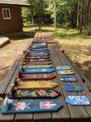
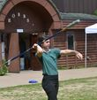
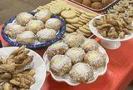
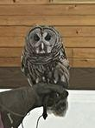
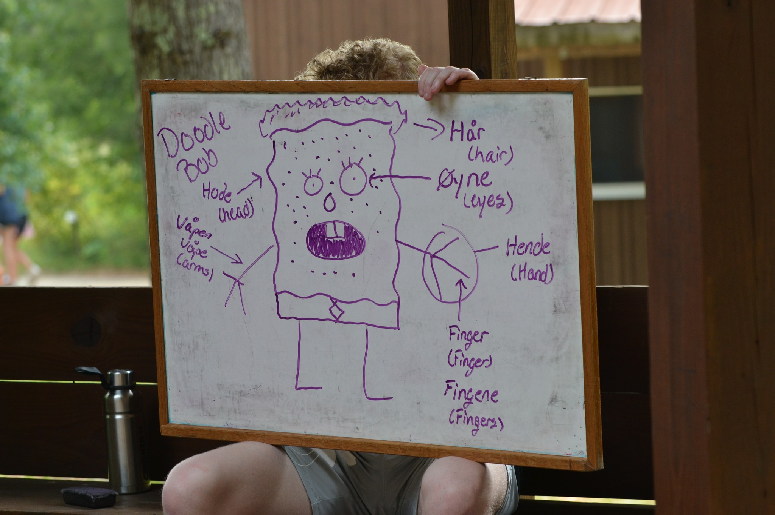
Activities
Just a few of our MANY activities include:
Learning the Norwegian language through…
- Book study
- Singing
- Acting/performing
- and more!
Baking Scandinavian recipes
Arts and craft work with professionals…
- Rosemaling
- Woodcarving
Nature presentations
Sports…

Slide 8
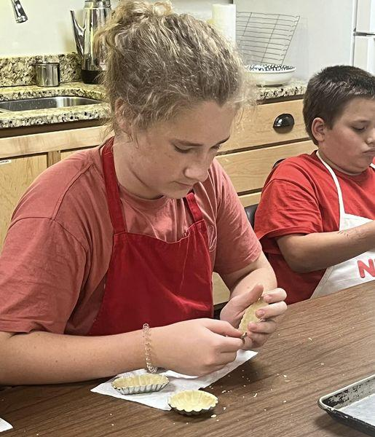
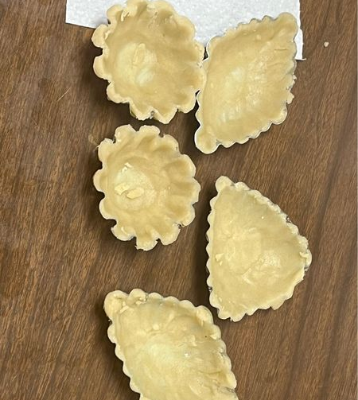
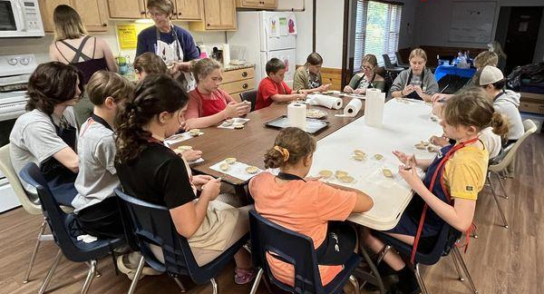
Making Sandbakkels!
Campers have opportunities to participate in baking activities. These campers learned to make Norwegian sugar cookies, which were then served with whipped cream and blueberries.

Slide 9
Another activity choose to do is Nordic stamping!
Nordic stamped cards by campers!

Slide 10
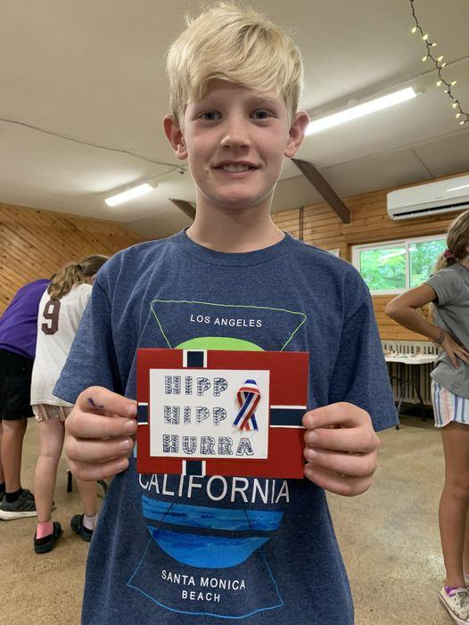
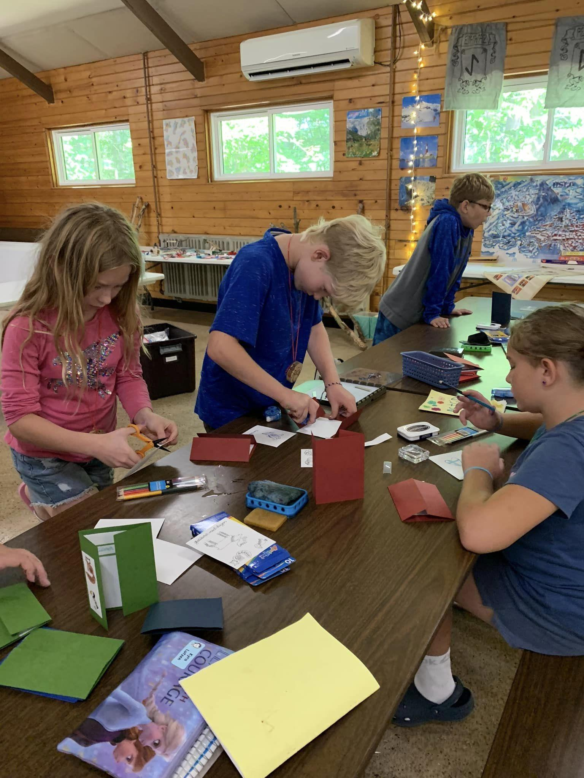
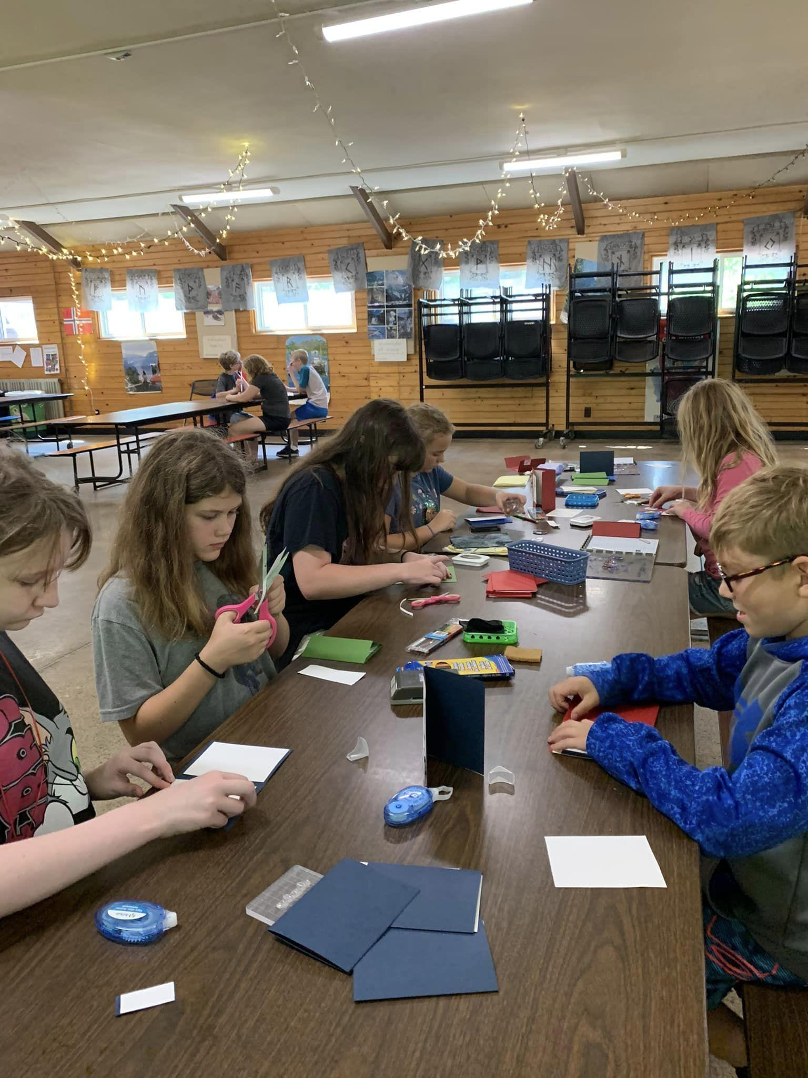
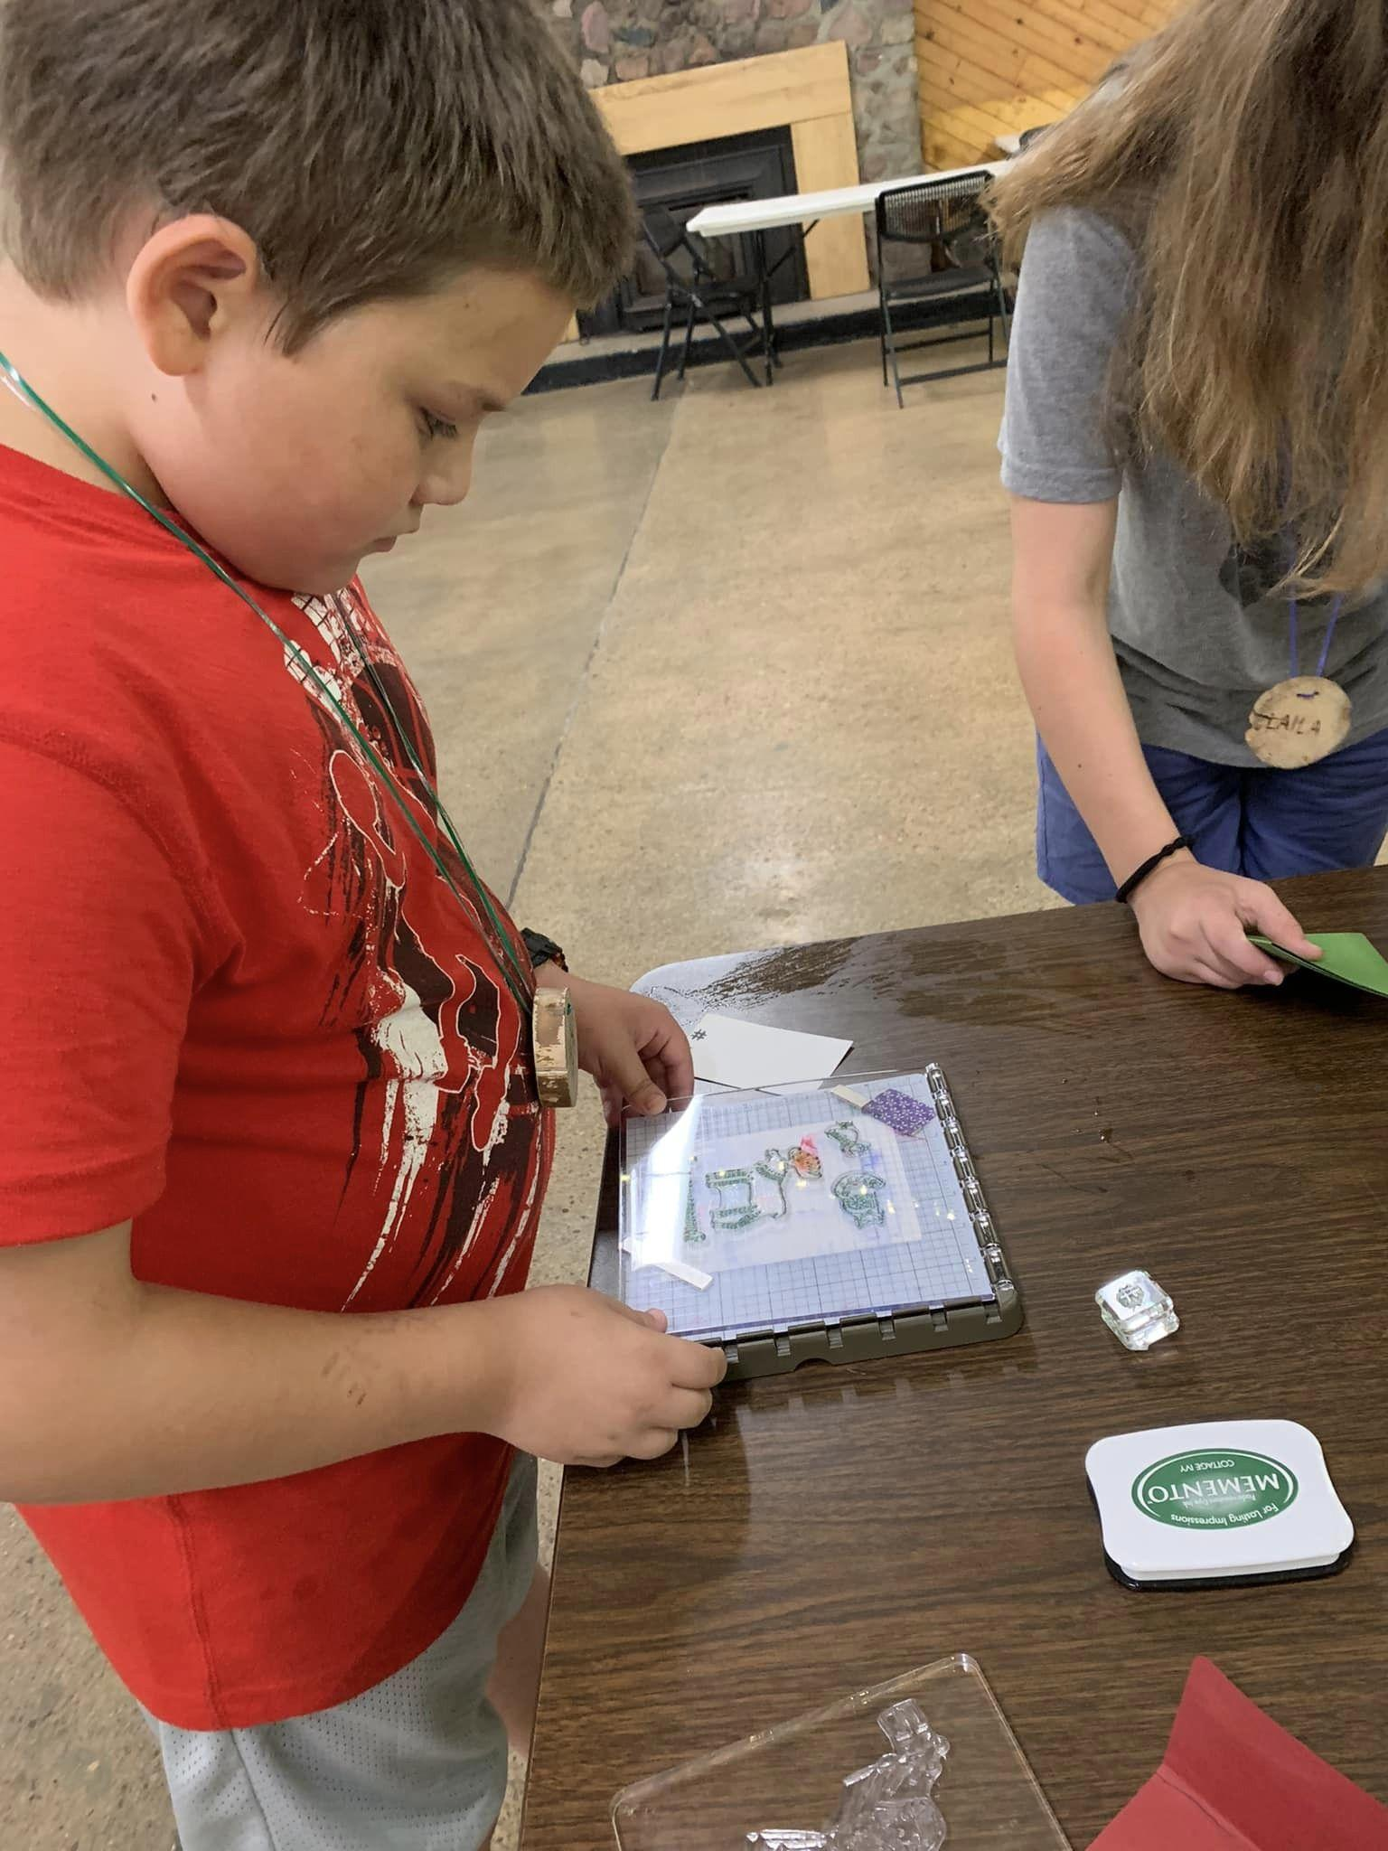

Slide 11
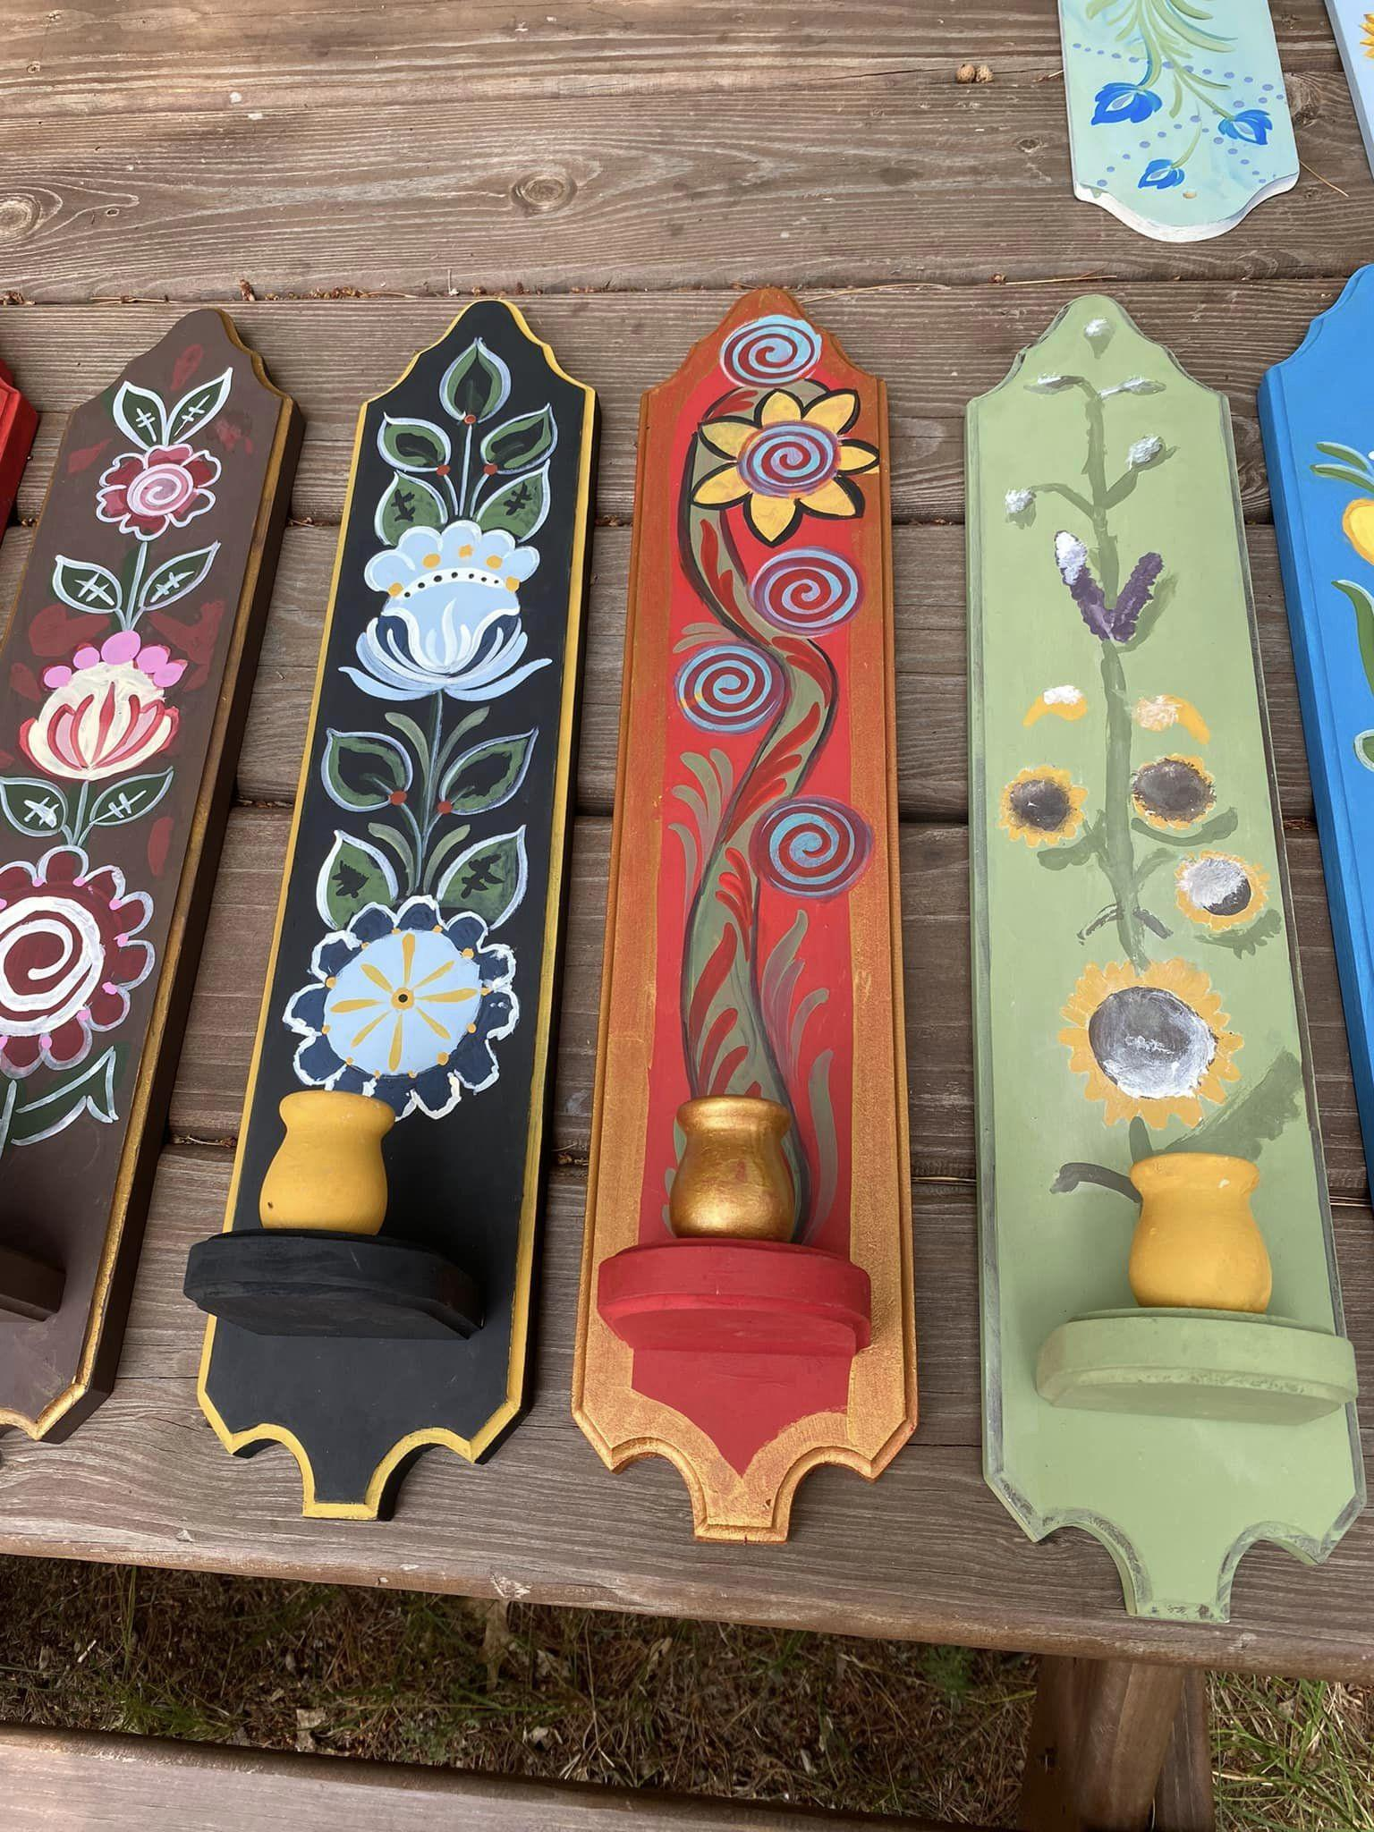
Another popular activity is rosemaling with our pro…

Slide 12
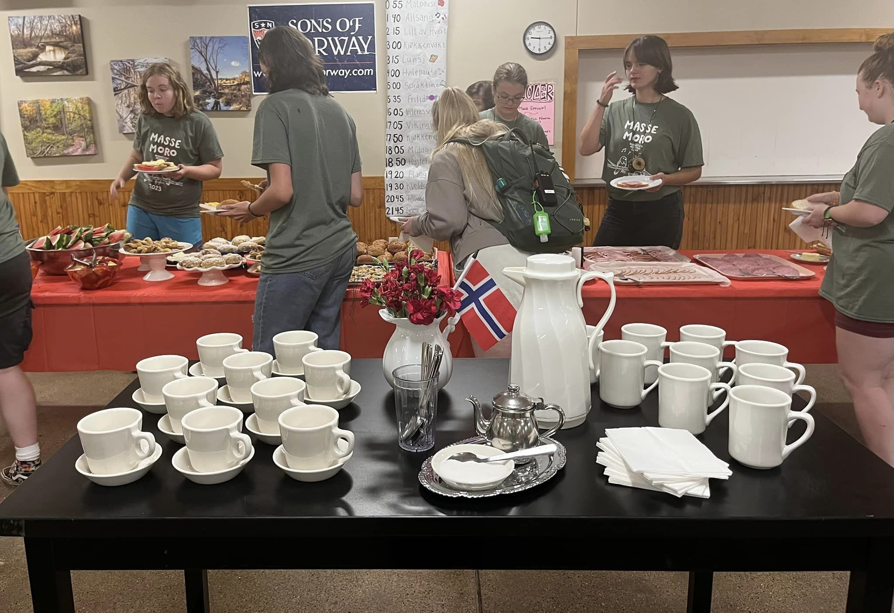
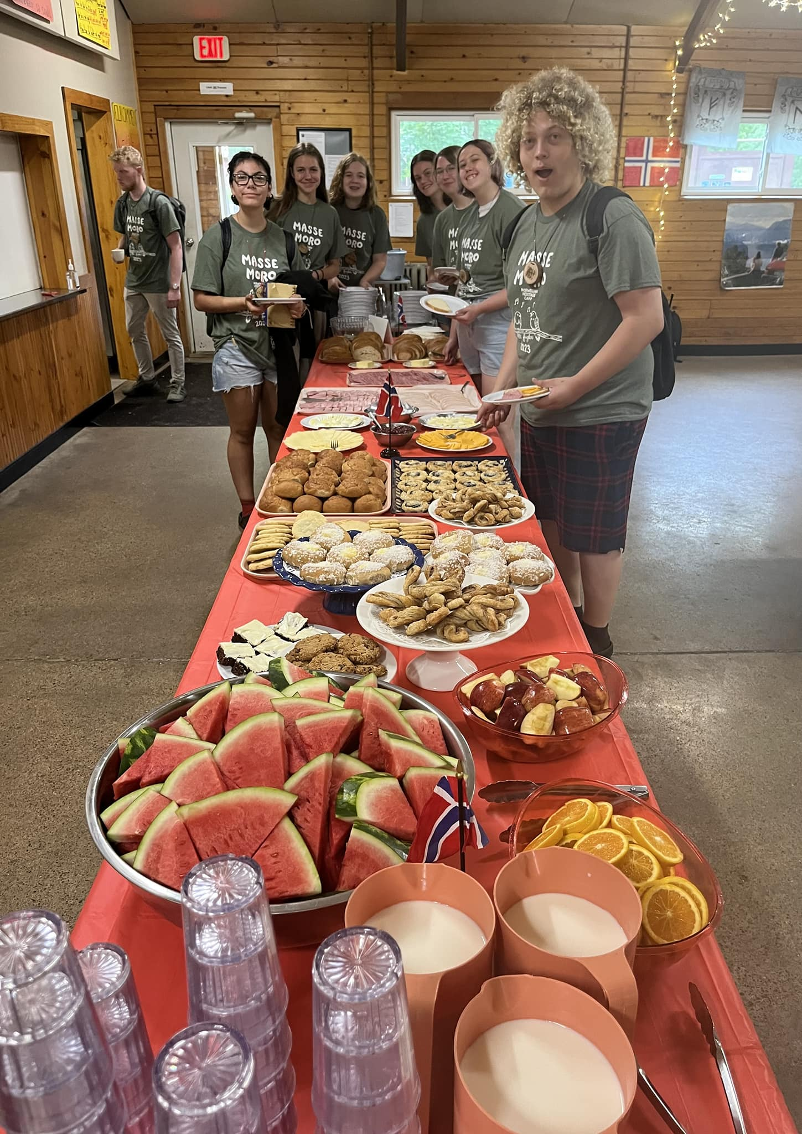
QUALITY MEALS WITH FOOD MADE FROM SCRATCH

Slide 13
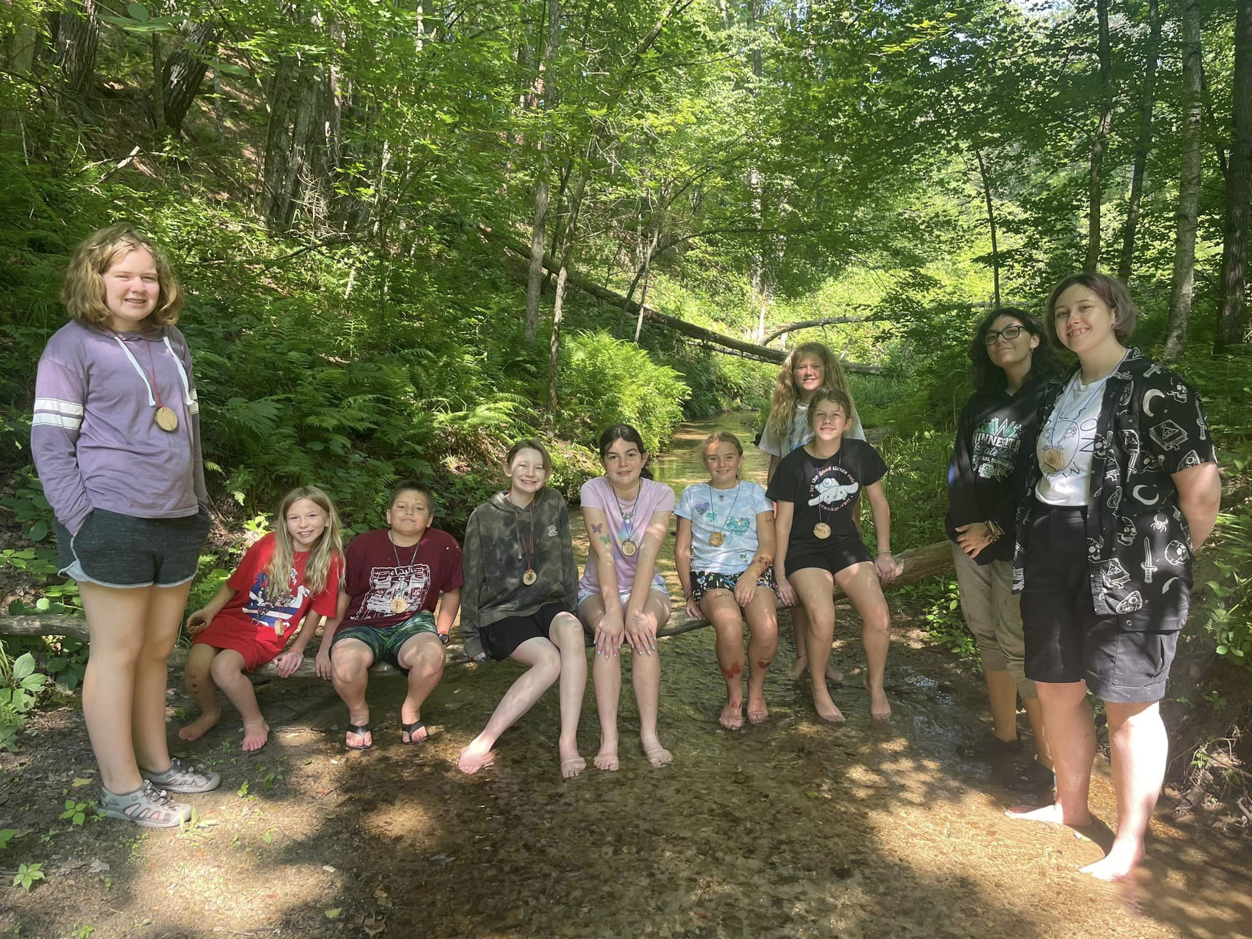
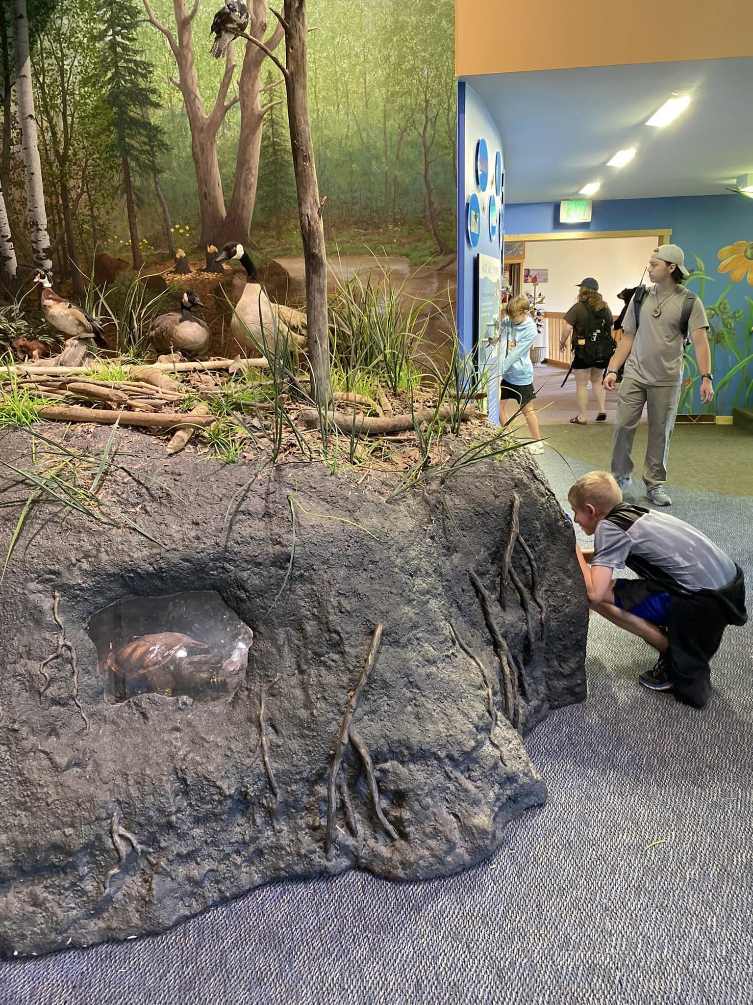
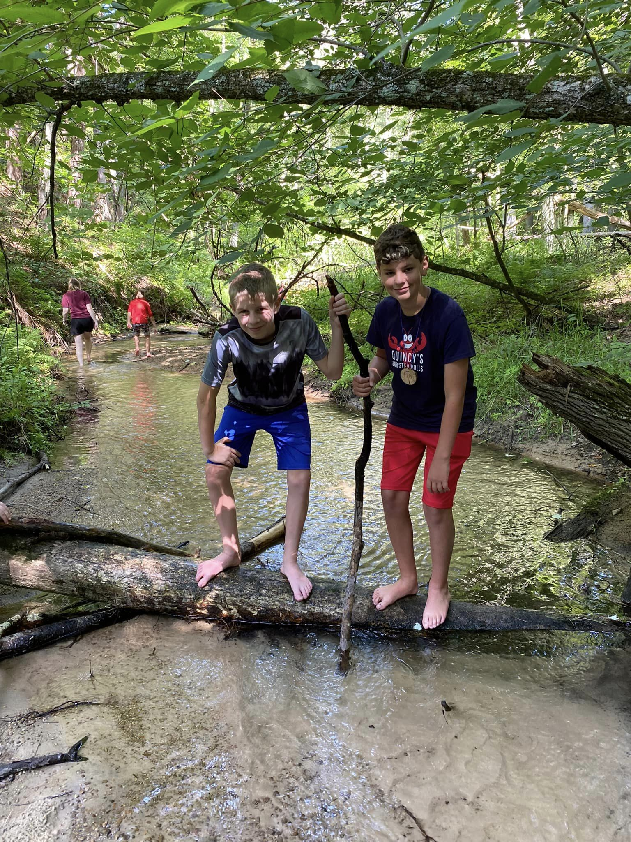
EXPERIENCE WISCONSIN NATURE
The Beaver Creek Nature Reserve is home to a our campsite, plus a nature center, a butterfly garden, an astronomic observatory, and over 80 acres of pristine nature

Slide 14
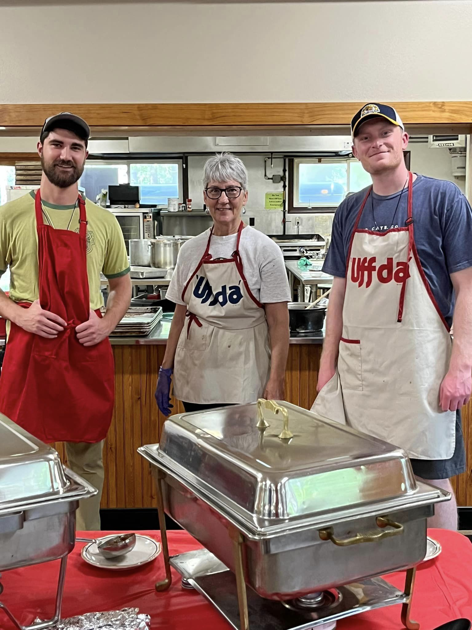
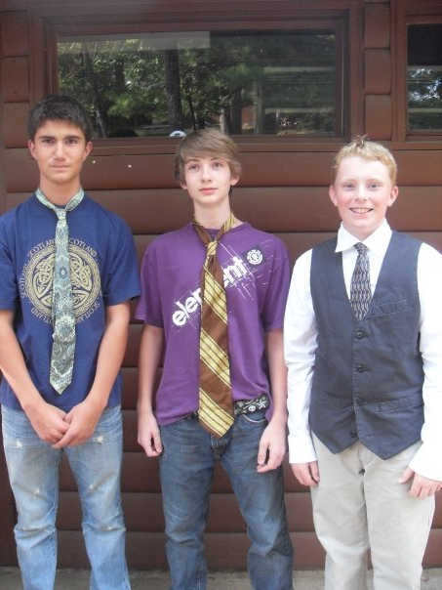
Form lasting relationships… Keir (left) and Leif (right), then and now: first campers, then counselors, now administrators and friends for life!

Slide 15
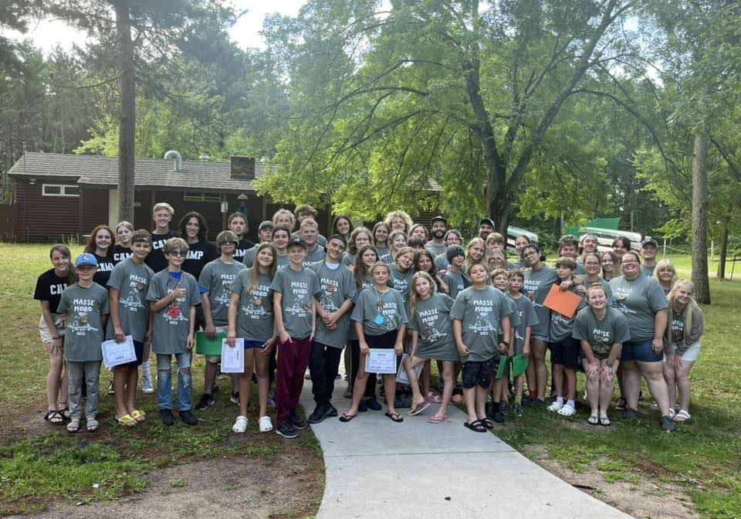
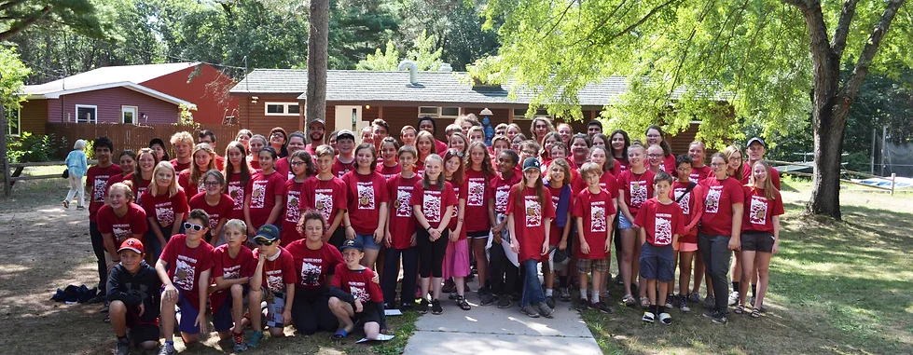
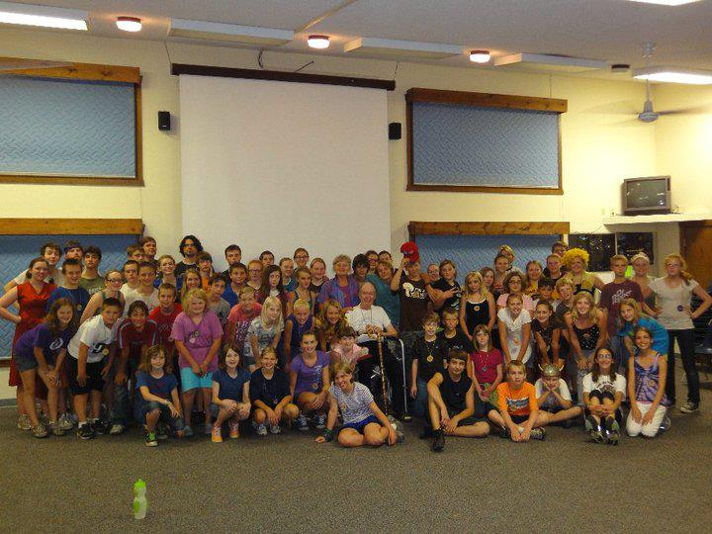
JOIN US THIS SUMMER!

